Slide 1
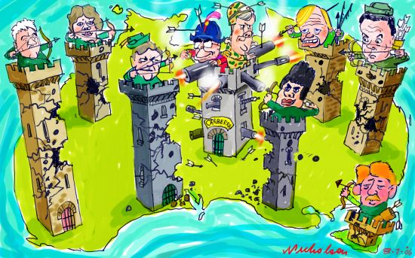
Federalism
By Mr. Siddharth Chandrasekar

Slide 2
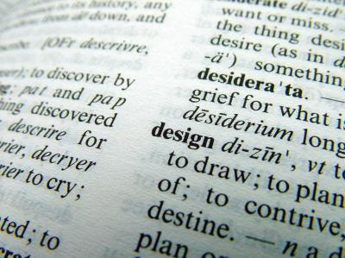
Definition
It is a system of govt. in which power is divided between a central authority and various constituent units of the country.

Slide 3

2 Levels of Government…
Government for the entire country
Governments at the level of provinces/states.
Both enjoy power independent of the other.
State Government has power of its own and not answerable to the centre.
Example : USA

Slide 4

Unitary Government…
Only one level of Government.
Sub units subordinated.
Centre can pass orders to the local Government.
Example : United Kingdom

Slide 5

Features of Federalism…
Has two /more levels of Govt.
Each level has its own Power or jurisdiction.
Jurisdiction is specified by the constitution.and there is constitutional guarantee of authority.
Constitutional provisions can be changed only with the consent of both levels of Govt.
Court interprets the constitution and powers of different levels of Govt. . Supreme court is the umpire if disputes arise with different levels of Govt.
Sources of revenue are clearly specified.

Slide 6

Objectives of Federalism…
To safeguard /promote the unity of the country.
To accommodate regional diversity.

Slide 7
Two Crucial Aspects of An Ideal Federalism
Governments at different levels should agree to some rules of power sharing.
Trust and agreement to live together must be there.

Slide 8

Difference Between...

Slide 9
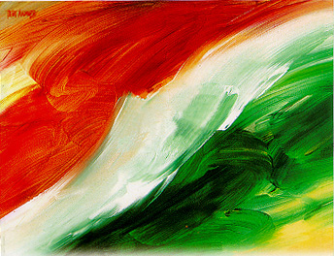
What has made India a Federal Country ?
Constitution has declared India as a Union of States.
Three tier Federalism-Union, State and Panchayat.
Three fold distribution of legislative powers under Union list, State list and Concurrent list.
All states in the Indian Union do not have identical powers. Eg. Union territories.
Changes in power sharing has to be passed by two thirds majority in the parliament.
In case of any dispute regarding division of power, the apex court will take decision.

Slide 11
How does India practice power sharing?
By creating linguistic states. Which has made administration easier.-New states have been created since 1947.
No language has been given the status of national language by the Constitution.
Restructuring of power sharing between Centre and State. Rise of regional political parties and coalition government has led to a new culture of power sharing.
Three fold distribution of legislative powers.

Slide 12

Residuary Powers…
Are subjects which do not fall under these three lists.
Union government alone has the power to make laws. Eg. Computer software.

Slide 13

Linguistic State...
Many new states have been formed, boundaries have been changed, people of common language have been brought together, state s created on the basis of culture, ethnicity and geography has made the country united and administration made easy.
Example NAGALAND, UTTARAKHAND AND JARKHAND.

Slide 14
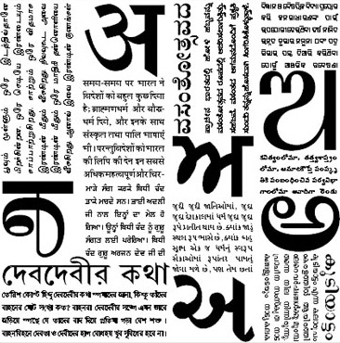
Language Policy
No language has been given the status of National language.
Central government can’t impose Hindi on non-Hindi speaking states .
22 languages have been recognised as scheduled languages.
Centre agrees to use English along with Hindi. By this flexibility is shown.

Slide 15

Centre State relation...
Central Government cannot undermine the powers of state or dismiss them.
Coalition Government - power sharing is more effective today.

Slide 16

What brought about the real success of Federalism in India?
Nature of democratic politics.
Respect for democratic politics.
Desire for living together.

Slide 17

What undermines the spirit of Federalism?
Centre misusing the Constitution to dismiss the State Government that was controlled by rival parties.
Coalition Governments led to a new culture of power sharing and respect for the autonomy of State Governments.

Slide 18

Whys?
Decentralisation…
When power is taken away from Central and State Governments and given to Local Governments.
Vastness of States in size and population.
Internally diverse.
Need for power sharing.

Slide 19

Basic idea behind Decentralisation…
Solving large number of problems and issues at local level.
People have better knowledge of problems in localities.
Better ideas on where to spend money and how to manage things efficiently.
Peoples participation in decision making.
To realize one important principle of democracy Local Government.

Slide 20

1992 Act…
brought in effective Decentralisation.
Steps taken for this by the Constitution are :
It is mandatory to hold regular elections to local governments.
Reservation of seats for SC,ST and BCS.
1/3SEATS RESERVED FOR WOMEN.
State election commission conducts elections.
State government share some power and revenue with local bodies.

Slide 21

Panchayatiraj – Local Self Government(Rural)

Slide 22
Local Government(Urban)

Slide 23

Difficulties faced by Local Governments...
Elections to Gram Sabhas are not held REGULARLY.
Most of the State Governments are not transferring powers and resources.

